Slide 1
6-DoF Semantics-Aware Condition- and Viewpoint-Invariant Visual SLAM
Confirmation of Candidature
Sourav Garg
Principal Supervisor : Michael Milford
Associate Supervisor: Niko Sunderhauf

Slide 2
Contents
Introduction
Literature Review
Research Questions
Research Plan
Work Progress
PhD Timeline

Slide 3
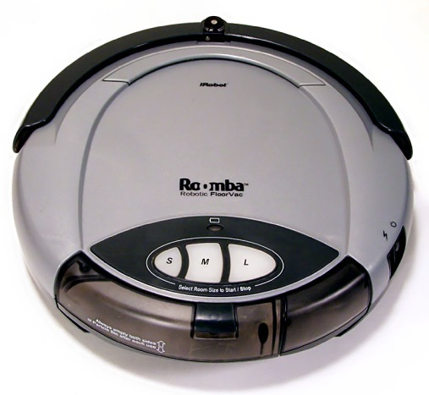
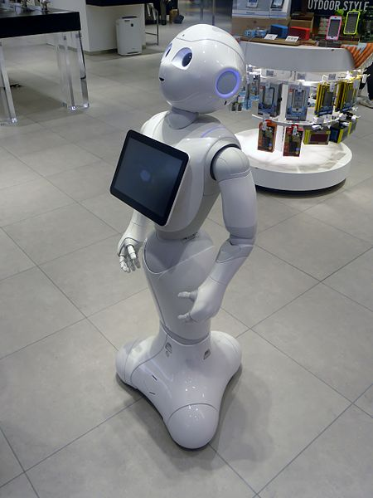
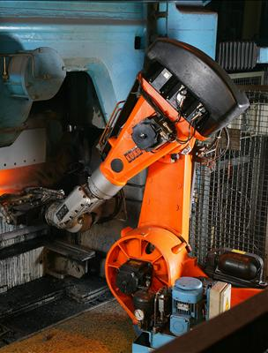
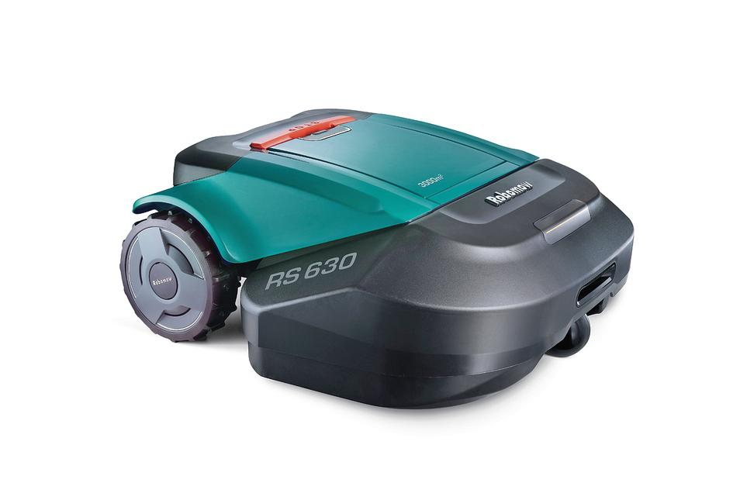
Introduction
Social [1]
Domestic [2,3]
Industrial [4]
https://en.wikipedia.org/wiki/Pepper_(robot)#/media/File:SoftBank_pepper.JPG
Larry D. Moore CC BY-SA 3.0 -https://en.wikipedia.org/wiki/Domestic_robot#/media/File:Roomba_original.jpg
http://www.robotshop.com/en/robomow-rs622-robot-lawn-mower.html
https://en.wikipedia.org/wiki/Robot#/media/File:Automation_of_foundry_with_robot.jpg

Slide 4
SLAM: Is it solved?
Simultaneous Localization and Mapping
Solved (Thrun and Niera [5]):
For Static Environments
Using Laser Rangefinder
Unsolved:
Vision Only
Extreme Appearance Change
Dynamic Objects
Semantic Understanding
[5] Frese, U., 2010. Interview: Is slam solved?. KI-Künstliche Intelligenz, 24(3), pp.255-257.

Slide 5
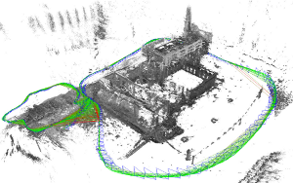
Visual SLAM
Use only Visual cues
Monocular or Stereo Vision using Digital Cameras
Components:
Visual Odometry
Visual Place Recognition
Representation Map
LSD-SLAM (Engel 2014)

Slide 6
Visual Place Recognition
Image Representation
Local Features – SIFT, SURF, BRIEF, ORB etc.
Bag of Words in FAB-MAP, ORB-SLAM etc.
Global Representation – ConvNet, Bit-Planes, HoG etc.
Direct Matching in LSD-SLAM, SeqSLAM etc.
Challenges
Perceptual Aliasing
Different places appear similar
Conditions Variations (Weather, Season, Time of day)
Same place appears different
Viewpoint Variations

Slide 7
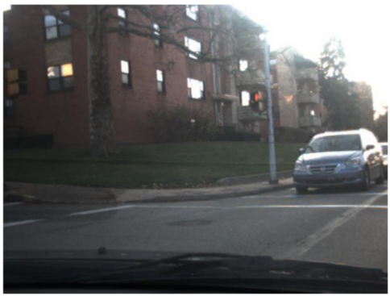
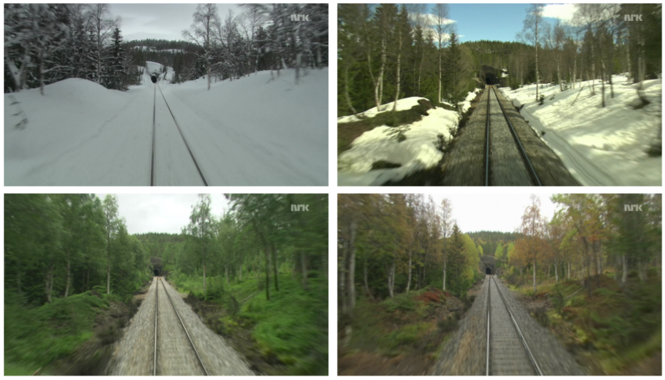
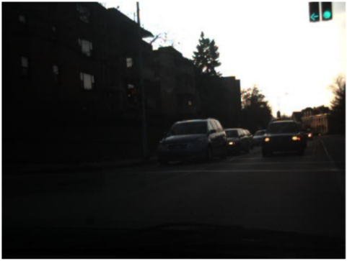
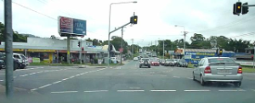

Environmental Conditions
Seasonal Variations in Nordland (Sunderhauf 2013)
SeqSLAM - Sunny Days vs Stormy Nights (Milford 2012)
Non-linear Intensity Deformation by Automatic Camera Settings (Alismail 2017)

Slide 8
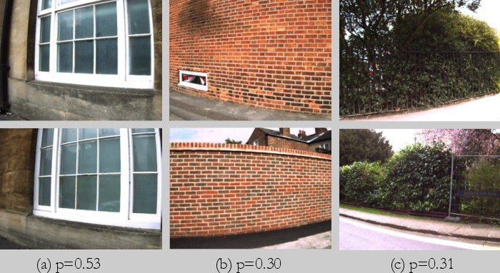
Perceptual Aliasing
Different Places with Similar Appearance (Cummins 2007)

Slide 9
Place Recognition – Review
Local Image Features
Robust to viewpoint changes
Prone to appearance variations
Global Representations
Robust to appearance variations
Prone to viewpoint variations
Deep-learned features
Robust in both cases
Lack relative 3D pose estimation

Slide 10
Visual Odometry
Matching consecutive images for Ego-motion estimation
Methods
Local Feature Tracking
FAST, SIFT, ORB etc. based feature correspondence
Direct Whole Image Matching
Hybrid Methods
Semi-Direct Visual Odometry (SVO)
Deep VO
PoseNet, Deep Tracking, Sfm-Net etc.
Challenges
Local Appearance variations
Low light environment
Rapid Camera Motion
Motion Blur
VO Failure is catastrophic for Visual SLAM

Slide 11
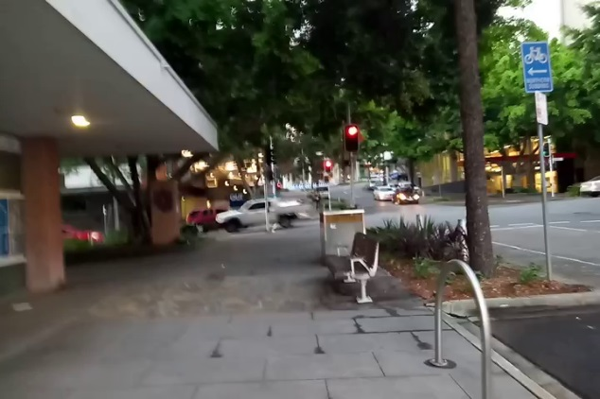
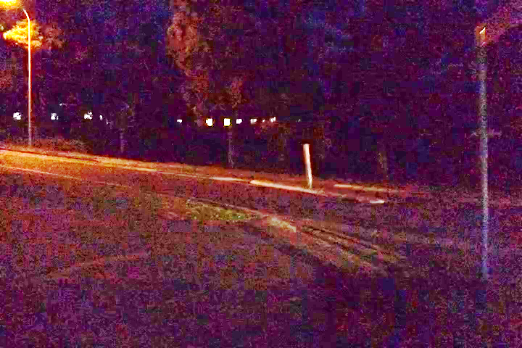
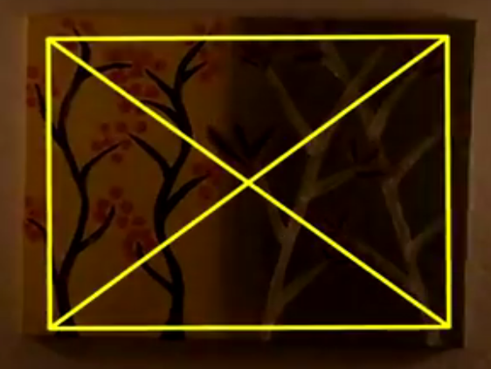
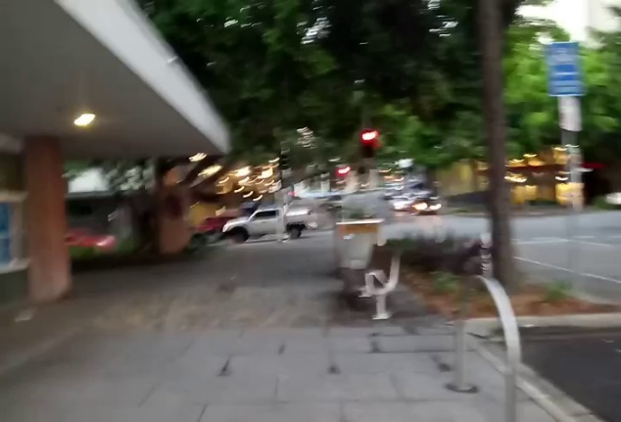
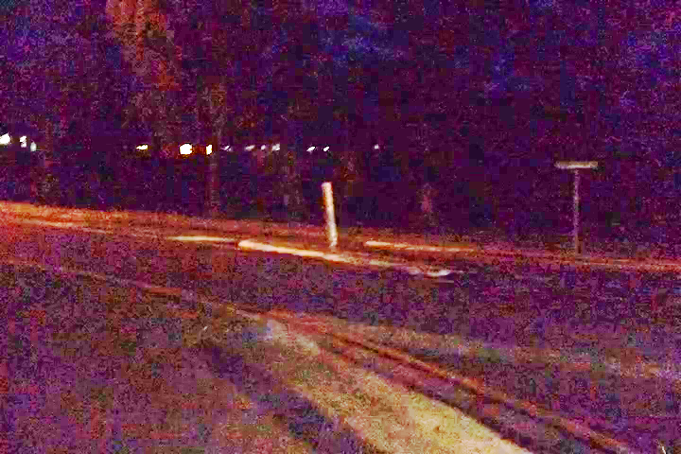
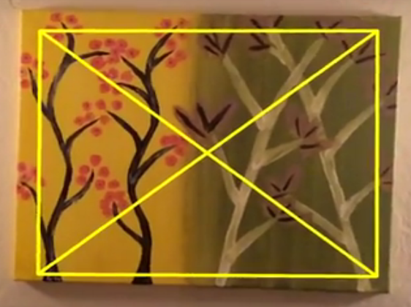
Some Challenges in Visual Odometry
Motion Blur
Low Light Environment
Illumination Variation
(Alismail 2016)

Slide 12
Representation Map
Types of Maps
Topological, Metric or Topometric
3D Reconstruction of Environment
6-DoF Visual SLAM systems
Sparse, Semi-Dense or Dense Reconstruction
Semantics in Maps
Meaningful interaction with environment
Aim: Metric Map with Semantic Topology

Slide 13
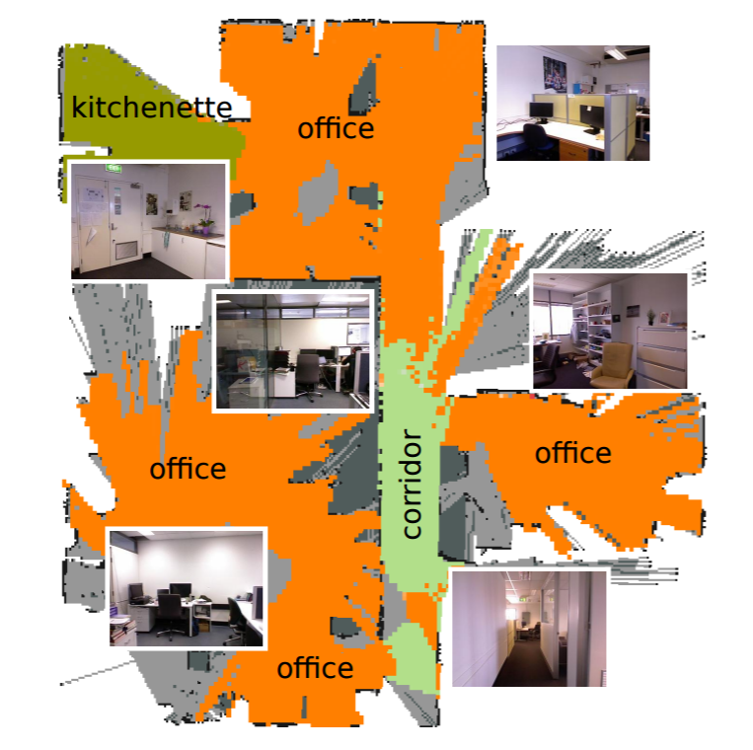

Probabilistic Semi-Dense Mapping (Mur-Artal 2015)
Place Categorization and Semantic Mapping (Sunderhauf 2016)

Slide 14
Semantics in Visual SLAM
Semantics within an Image
Object-Oriented
Deep-learned Object Recognition
Sparse or Dense Object Segmentation
Semantic Structures like wall, ceiling, floor etc.
Place Semantics
Place-centric vs Object-centric Approach
Place Categories and Attributes
Structural – Train Station, Kitchen, Bedroom etc.
Transient – Night, Rain, Snow etc.

Slide 15
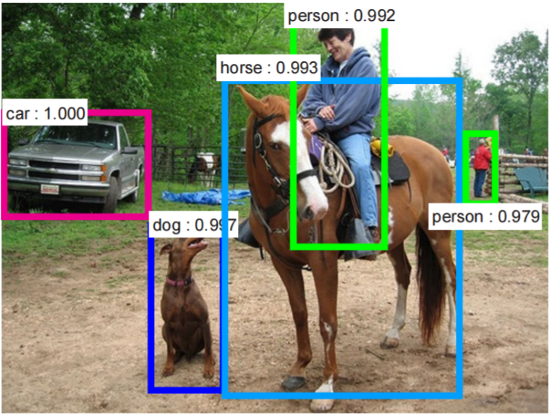
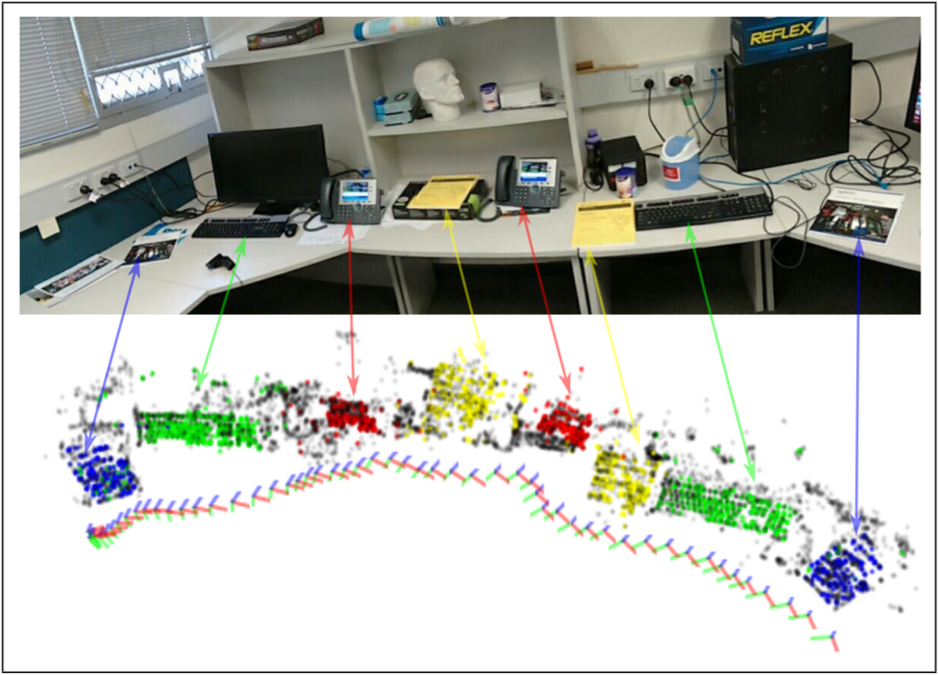
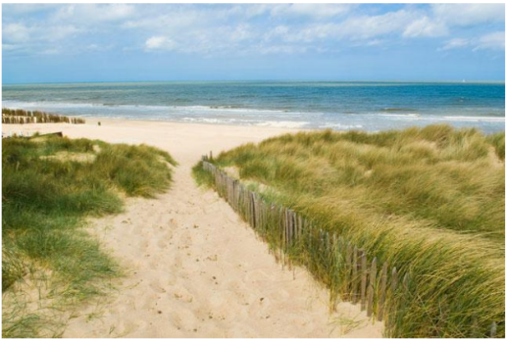
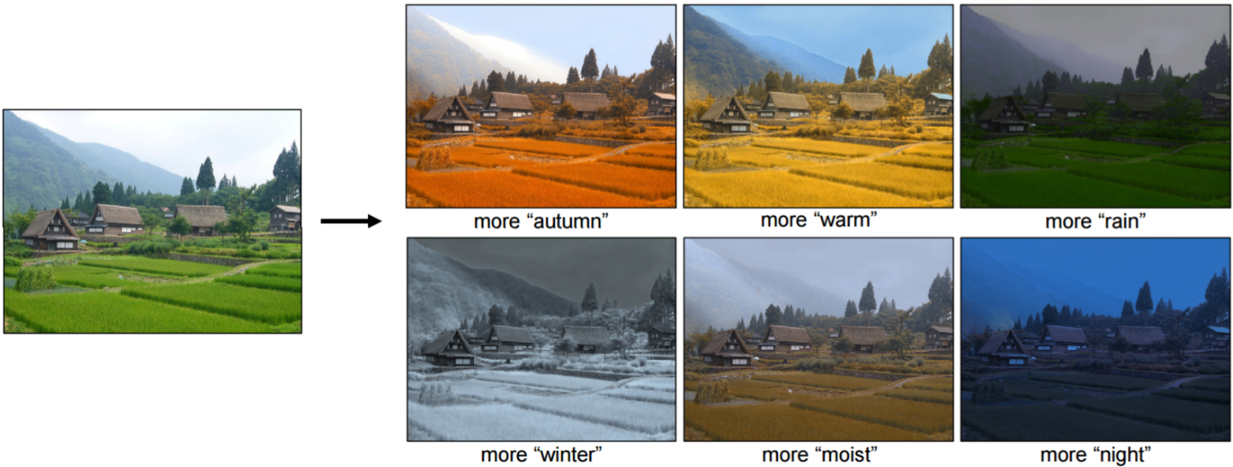
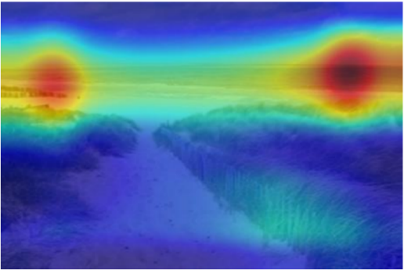
Object Detection Using Faster R-CNN (Ren 2015)
Multi-Object SLAM (Dharmasiri 2016)
Scene Recognition Using Places Database (Zhou 2014)
Transient Attributes for Outdoor Scene Editing (Laffront 2014)

Slide 16
Problem Statement
How can we develop a general purpose 6-DoF semantics-aware condition- and viewpoint-invariant visual SLAM system?

Slide 17
Research Questions
How can we characterize a visual SLAM system against variations in environment and ego-motion, and make it more robust for both visual place recognition and visual odometry?
How can semantic information related to images add value to a visual SLAM system?
Can we develop a general purpose 6-DoF semantics-aware SLAM system robust to condition and viewpoint variations.

Slide 18
Research Plan
Characterizing and Adapting Visual SLAM system
Viewpoint- and Condition-Invariance
Adapting to Variations Within Environment
Ego-motion Estimation for Low Light and Rapid Movement
Semantics for Visual Place Recognition
Robust Semantic Representation
Semantics Across Places
Semantics Within Places
6-DoF Semantics-Aware Visual SLAM
Condition-Invariant 3D Relative Pose Estimation
Semantics for SLAM
An integrated system

Slide 19
RQ:1 - Characterizing and Adapting Visual SLAM
Characterizing Viewpoint and Condition Invariance
Place Recognition – SeqSLAM
Visual Odometry – ORB-SLAM
Adapting to Variations Within Environment
Transitions in Environment
Indoor/Outdoor, Naturally-Lit/Artificially-Lit etc.
Environment Segmentation
Improve Place Recognition
Ego-motion Estimation for Low Light and Rapid Movement
Speed Estimation for Visual Odometry
Speed-Normalized Data Sampling for Place Recognition

Slide 20
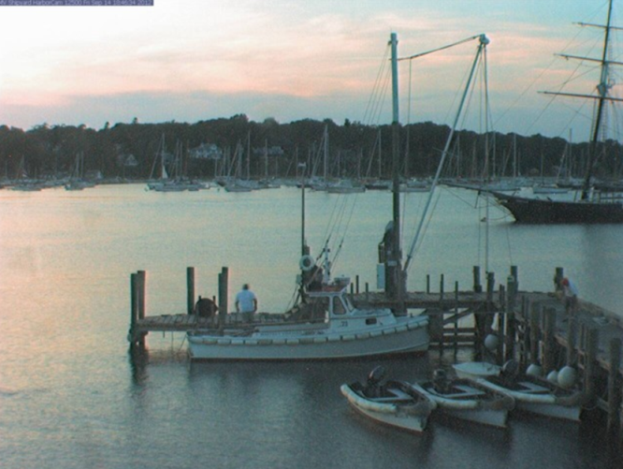
RQ:2.1 – Robust Semantic Representation
Place-Centric Semantics (Zhou 2014)
Environment Type
Outdoor
Categories
Harbor -0.44
Dock – 0.33
Boat Deck – 0.10
Attributes
Open Area
Natural Light
Far-Away Horizon
Man-Made
Transient Attributes (Laffront 2014)
Time of Day
Sunrise/Sunset – 0.59
Weather
Sunny/Direct Sun – 0.39
Clouds/Overcast – 0.27
Season
Summer – 0.34
Winter – 0.07
Object-Centric Semantics (Jia 2014)
Vessel – 1.26
Craft – 1.17
Vehicle – 0.80
Ship – 0.76

Slide 21
RQ:2.1 – Robust Semantic Representation
Planned Approach
Method
Deep Convolutional Neural Network
Multi-label (2D) Classification
Image Databases
ImageNet, Places2, AMOS etc.
Ground Truth Labelling
Cross-Labelling using state-of-the-art classifiers
Transfer Labels using Place Recognition
Anticipated Challenges
Class Balancing
Data Insufficiency
Expected Outcomes
Performance benchmark for outdoor scene categorization
Study utility for Condition-Invariant Place Recognition

Slide 22
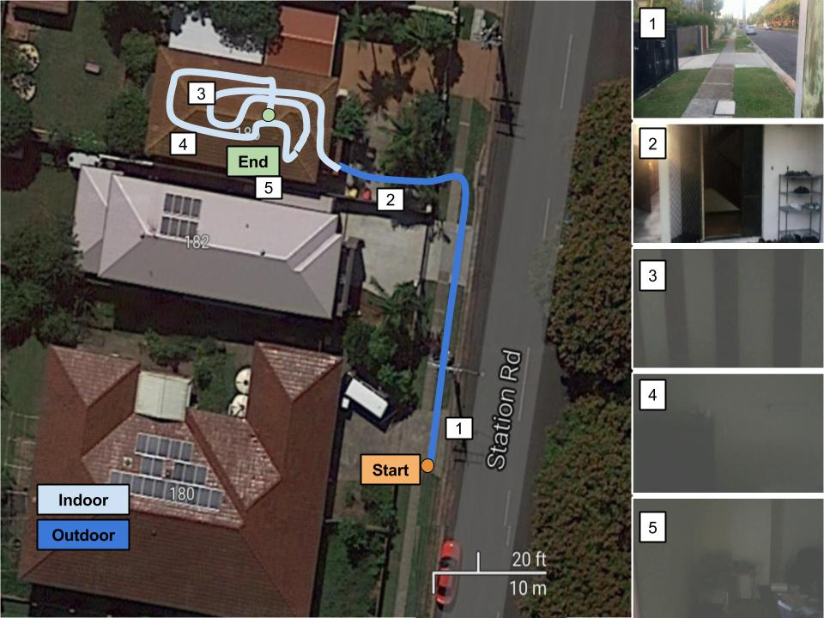
RQ:2.2 - Semantics Across Places
Planned Approach
Temporal Clustering of Semantic Labels
Segment Environment
Office Space - Cubicles, Canteen, Corridor, Restroom etc.
Vehicle on Roads - Urban Canyon, Highway, Tunnel etc.
Expected Outcome
Categorize and Recognize in a Reduced Search Space
Coarse Semantic Localization
Study Computational Gain for very large databases
Seamless Transitions Within Environment
Indoor/Outdoor, Naturally/Artificially Lit, Bland/Cluttered
Benchmark place recognition performance against state-of-the-art methods
Indoor-Outdoor Seamless Localization

Slide 23
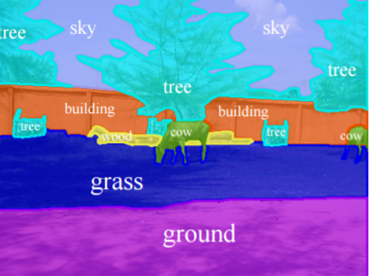
RQ:2.3 - Semantics Within Places
Planned Approach
Use state-of-the-art semantic segmentation
Object-level or Pixel-level
Learn semantically salient objects/patches for place recognition
Semantic Annotations (Mottaghi 2014)
Expected Outcome
Determine condition-invariant semantic entities
Determine dynamic objects in environment
Performance Benchmark for place recognition with dynamic objects and condition variations

Slide 24
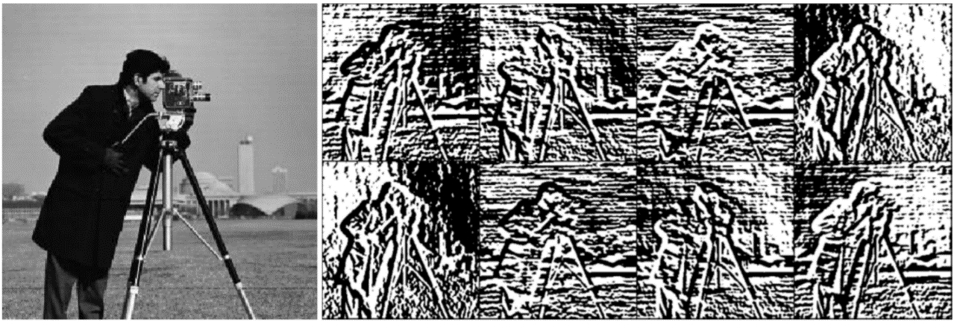
RQ:3.1 – Condition-Invariant 3D Relative Pose
Planned Approach
Condition-Invariant Place Description
Exploring Bit-Planes Descriptor (Alismail 2016)
Direct Image Alignment in LK framework
Assuming Descriptor Constancy as opposed to Brightness Constancy
Expected Outcome
3D Relative Pose Estimation for Condition-Invariant Place Recognition
6-DoF Condition-and Viewpoint-Invariant Visual SLAM system
8-Channel Bit-Plane Descriptor can be used within a multi-channel LK framework using SSD cost measure (Alismail 2016)

Slide 25
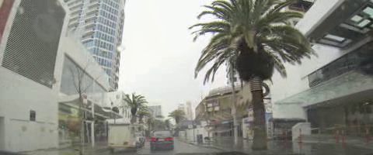
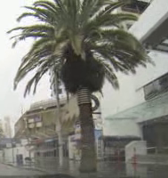
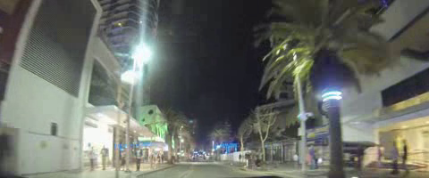
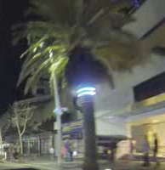
RQ:3.2 – SLAM for Semantics
Building – 0.66
Royal Palm - 0.61
Palm – 0.73
Tree – 0.73
Plant – 0.73
Royal Palm - 0.71
Palm – 0.95
Tree – 0.95
Plant – 0.95
Key Palm – 0.66
Great Hall – 0.61
Hall – 0.61
Room – 0.72
Atrium of Building – 0.61
Courtyard – 0.61
Tesla Coil – 0.80
Electrical Device – 0.80
Device – 0.80
Royal Palm – 0.79
Palm – 0.79
IBMWatson Developer Cloud – Bluemix Visual Recognition Demo - https://visual-recognition-demo.mybluemix.net/

Slide 26
RQ:3.2 – SLAM for Semantics
Planned Approach
Recognize places and improve semantic labelling
Generate a prior probability for environment labels
Where appearance of environment has changed
Using cues from appearance-robust place recognition
Expected Outcome
Establish utility of place recognition for semantics
Benchmark Object Recognition Performance within a Visual SLAM framework

Slide 27
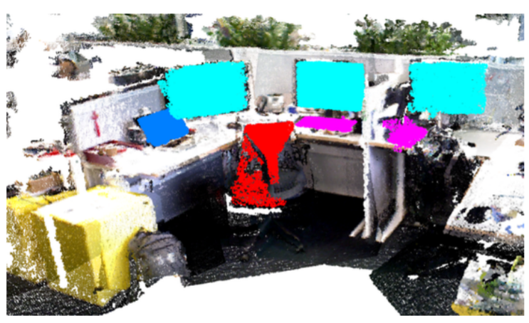
RQ:3.3 – An Integrated System
Integrate the modified and newly developed components
6-DoF Semantics-Aware Condition- and Viewpoint-Invariant Visual SLAM system
Semantically-Interactive 3-D Map
Object Oriented Semantic Mapping (Sunderhauf 2016)

Slide 28
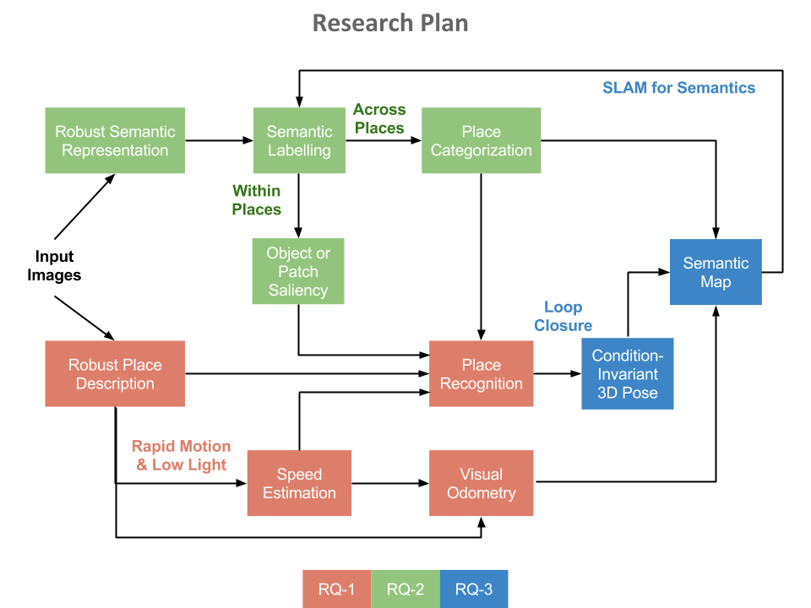

Slide 29
Work Progress
Performance Evaluation using High-Fidelity Simulation
Place Recognition – SeqSLAM
Visual Odometry – ORB-SLAM
Semantic Segmentation of Environment
Transitions in Environment
Improve Condition-Invariant Place Recognition
Ego-motion Estimation in Unfavourable Conditions
Hybrid Visual Odometry
Speed-Normalized Data Sampling for Place Recognition

Slide 30
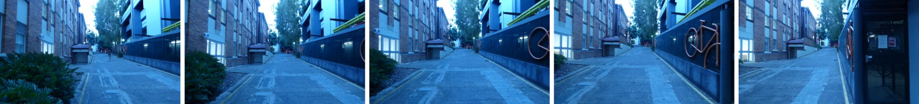
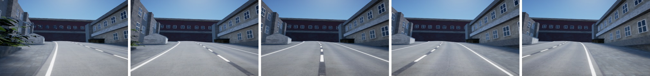
Characterizing Visual SLAM
Performance Evaluation Using High-Fidelity Simulation
Viewpoint- and Condition-Invariance
Place Recognition using SeqSLAM
Visual Odometry using ORB-SLAM
(Skinner 2016)

Slide 31
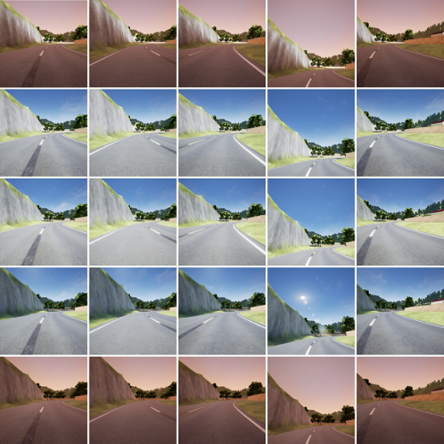
(Skinner 2016)

Slide 32
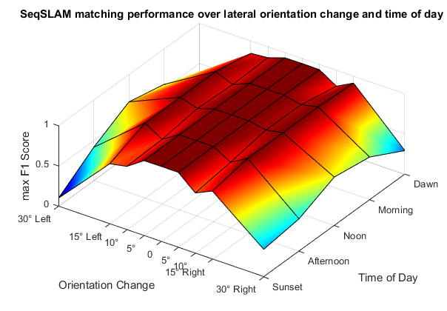
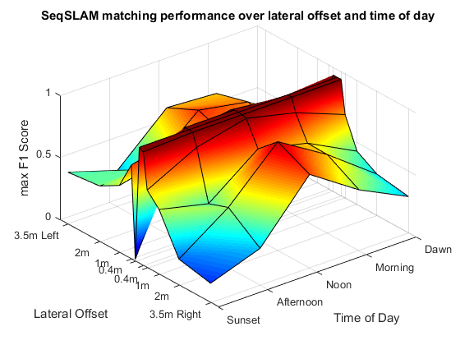
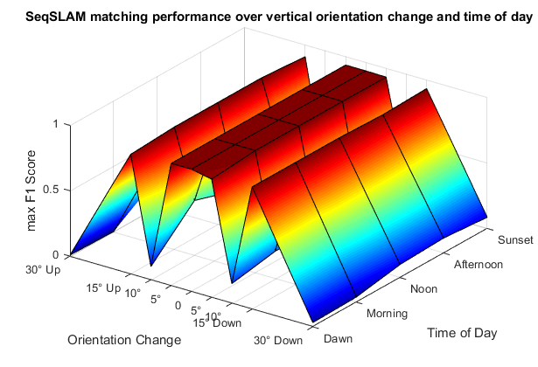
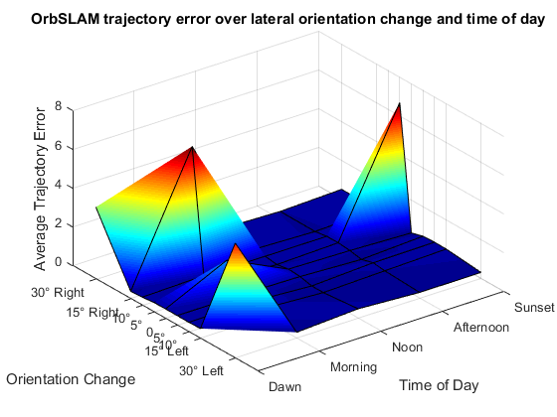
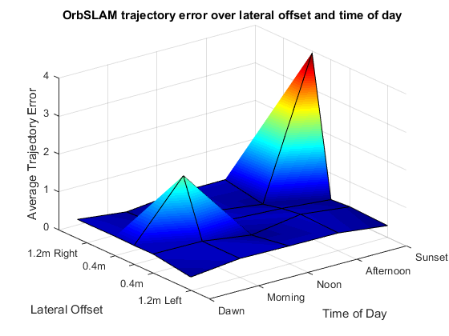
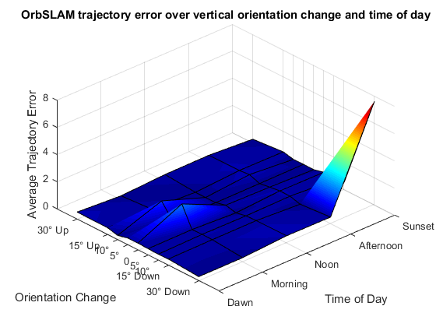
SeqSLAM – Place Recognition
ORB-SLAM – Visual Odometry

Slide 33
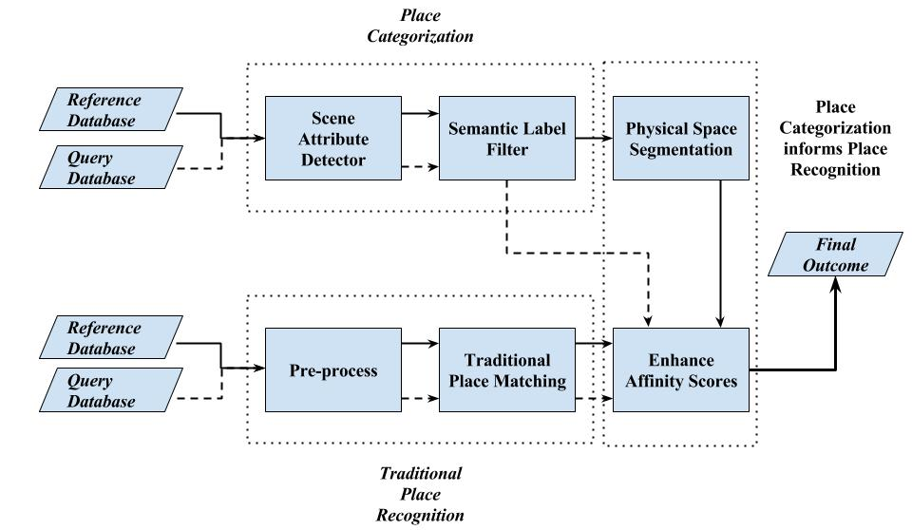
Adapting to Environment
Semantic Segmentation of Environment
Improving Place Recognition

Slide 34
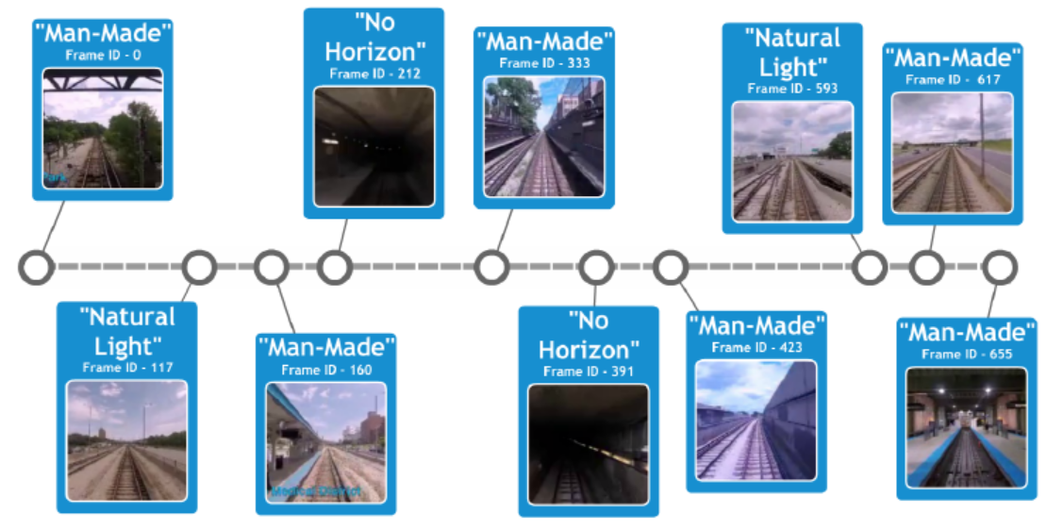
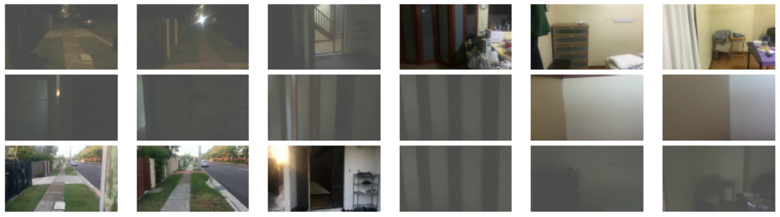
Semantic Labels for Segmented Environment
Extreme Variations in Appearance Within Environment
Ground Truth
Vanilla SeqSLAM
Proposed Approach

Slide 35
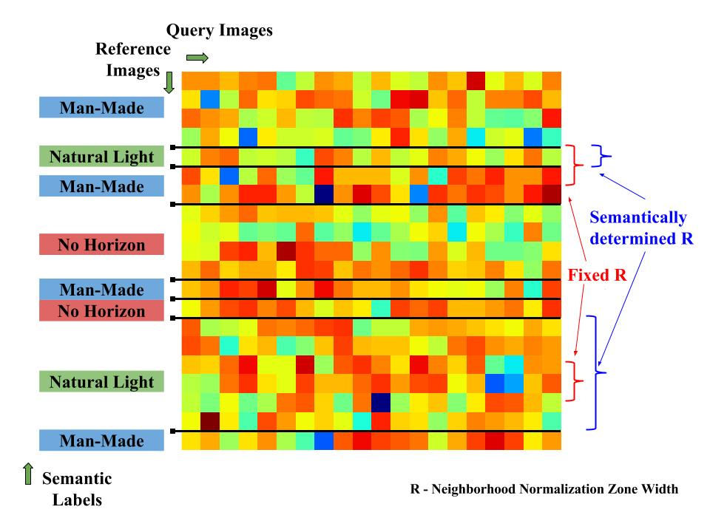
Performance Changes
More pronounced with extreme variations within environment
Global Conditions
If similar – Global minima generally works
If different – Depends on Query Image
Semantics later replaced by segmentation based on image matching score

Slide 36
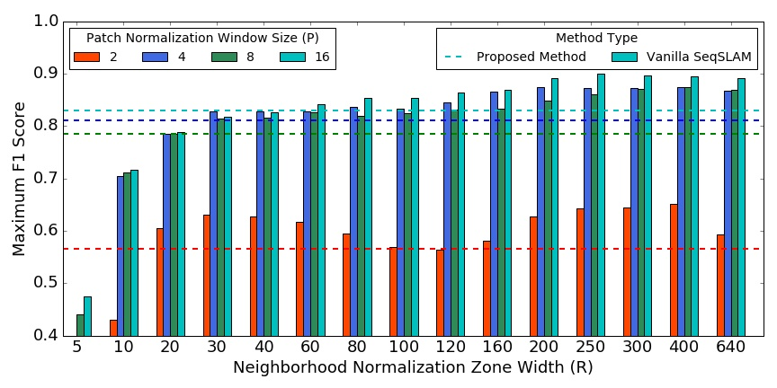
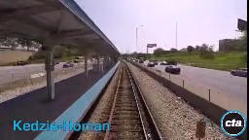
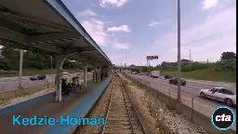
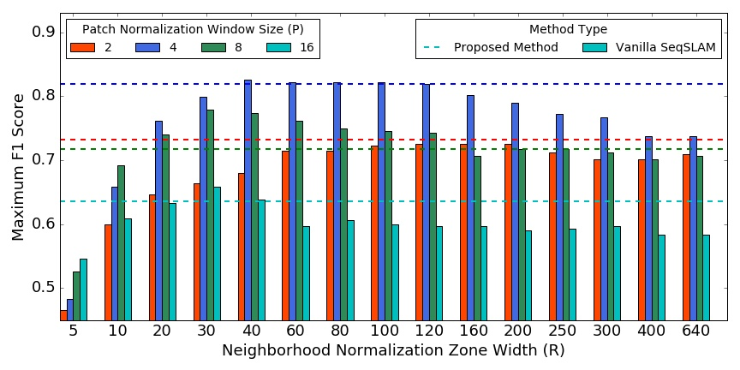
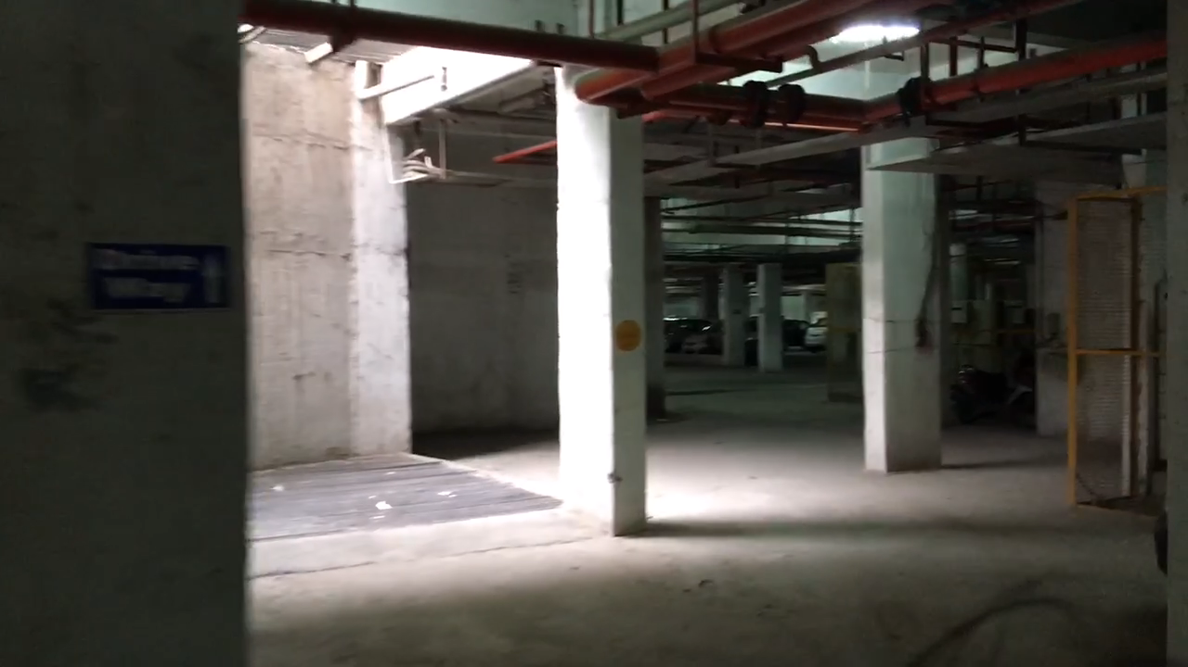


Slide 37


Ego-motion for Unfavourable Conditions
Speed Estimation
Low Light and Rapid Motion
Approximate Linear Relationship between Appearance and Geometry (Lukas and Kanade 1981)
Image Matching Score vs Frame Separation
Campus Indoor-Outdoor Dataset
Home Indoor-Outdoor Dataset

Slide 38


Night Traverse
Day Traverse
Kelvin Grove On-Foot Dataset featuring Low Light Environment and Rapid Motion

Slide 39
Image Matching Using
Patch-Normalized Images with SAD Score
Bit-Plane Descriptor with SSD Score
Polynomial fitting - SAD score and Frame Separation
Challenges
Depends on Environment
Is 1-D
State-of-the-art VO failure reasons
Less features in low-light for ORB-SLAM
Mainly rapid motion for LSD-SLAM
Possible Uses
Hybrid approach with state-of-the-art
Adapting parameters with change in speed

Slide 40




Improving Place Recognition
Speed-Normalized Data Sampling
Ground Truth Trajectory Comparison
Vehicle Moving in Heavy Traffic Conditions
Varying Pedestrian Motion on Footpath

Slide 41






Vehicle Moving in Heavy Traffic Conditions
Varying Pedestrian Motion on Footpath

Slide 42
Publications To Date
Skinner, J., Garg, S., Sünderhauf, N., Corke, P., Upcroft, B. and Milford, M., 2016, October. High-fidelity simulation for evaluating robotic vision performance. In Intelligent Robots and Systems (IROS), 2016 IEEE/RSJ International Conference on (pp. 2737-2744). IEEE.
Improving Condition- and Environment-Invariant Place Recognition with Semantic Place Categorization
Under Review - IROS 2017

Slide 43
Target Publications
Adapting to Variations within Environment
IROS’17
Ego-motion Estimation for Low-Light and Rapid Camera Motion
ICRA’18
Holistic Semantic Representation
IROS’18
Semantics Within and Across Places
ICRA’19
Condition-Invariant Relative 3-D Pose Estimation for Condition- and Viewpoint-Invariant Visual SLAM
IROS’19
6-DoF Semantics-Aware Visual SLAM
IJRR/TRO

Slide 44
PhD Timeline

Slide 45
References
Engel, Jakob, Thomas Schöps, and Daniel Cremers. "LSD-SLAM: Large-scale direct monocular SLAM." European Conference on Computer Vision. Springer International Publishing, 2014.
Sünderhauf, N., Neubert, P. and Protzel, P., 2013, May. Are we there yet? Challenging SeqSLAM on a 3000 km journey across all four seasons. In Proc. of Workshop on Long-Term Autonomy, IEEE International Conference on Robotics and Automation (ICRA) (p. 2013).
Alismail, H., Kaess, M., Browning, B. and Lucey, S., 2017. Direct Visual Odometry in Low Light Using Binary Descriptors. IEEE Robotics and Automation Letters, 2(2), pp.444-451.
Milford, M.J. and Wyeth, G.F., 2012, May. SeqSLAM: Visual route-based navigation for sunny summer days and stormy winter nights. In Robotics and Automation (ICRA), 2012 IEEE International Conference on (pp. 1643-1649). IEEE.
Cummins, M. and Newman, P., 2007, April. Probabilistic appearance based navigation and loop closing. In Robotics and automation, 2007 IEEE international conference on (pp. 2042-2048). IEEE.
Alismail, H., Browning, B. and Lucey, S., 2016, October. Robust tracking in low light and sudden illumination changes. In 3D Vision (3DV), 2016 Fourth International Conference on (pp. 389-398). IEEE.
Mur-Artal, R. and Tardós, J.D., 2015, July. Probabilistic Semi-Dense Mapping from Highly Accurate Feature-Based Monocular SLAM. In Robotics: Science and Systems.
Sünderhauf, N., Dayoub, F., McMahon, S., Talbot, B., Schulz, R., Corke, P., Wyeth, G., Upcroft, B. and Milford, M., 2016, May. Place categorization and semantic mapping on a mobile robot. In Robotics and Automation (ICRA), 2016 IEEE International Conference on (pp. 5729-5736). IEEE.

Slide 46
References
Ren, S., He, K., Girshick, R. and Sun, J., 2015. Faster r-cnn: Towards real-time object detection with region proposal networks. In Advances in neural information processing systems (pp. 91-99).
Zhou, B., Lapedriza, A., Xiao, J., Torralba, A. and Oliva, A., 2014. Learning deep features for scene recognition using places database. In Advances in neural information processing systems (pp. 487-495).
Laffont, P.Y., Ren, Z., Tao, X., Qian, C. and Hays, J., 2014. Transient attributes for high-level understanding and editing of outdoor scenes. ACM Transactions on Graphics (TOG), 33(4), p.149.
Dharmasiri, T., Lui, V. and Drummond, T., 2016, October. MO-SLAM: Multi object SLAM with run-time object discovery through duplicates. In Intelligent Robots and Systems (IROS), 2016 IEEE/RSJ International Conference on (pp. 1214-1221). IEEE.
Jia, Y., Shelhamer, E., Donahue, J., Karayev, S., Long, J., Girshick, R., Guadarrama, S. and Darrell, T., 2014, November. Caffe: Convolutional architecture for fast feature embedding. In Proceedings of the 22nd ACM international conference on Multimedia (pp. 675-678). ACM.
Sünderhauf, N., Pham, T.T., Latif, Y., Milford, M. and Reid, I., 2016. Meaningful Maps $-$ Object-Oriented Semantic Mapping. arXiv preprint arXiv:1609.07849.
Alismail, H., Browning, B. and Lucey, S., 2016. Bit-planes: Dense subpixel alignment of binary descriptors. arXiv preprint arXiv:1602.00307.
Skinner, J., Garg, S., Sünderhauf, N., Corke, P., Upcroft, B. and Milford, M., 2016, October. High-fidelity simulation for evaluating robotic vision performance. In Intelligent Robots and Systems (IROS), 2016 IEEE/RSJ International Conference on (pp. 2737-2744). IEEE.
Mottaghi, R., Chen, X., Liu, X., Cho, N.G., Lee, S.W., Fidler, S., Urtasun, R. and Yuille, A., 2014. The role of context for object detection and semantic segmentation in the wild. In Proceedings of the IEEE Conference on Computer Vision and Pattern Recognition (pp. 891-898).

Slide 47
Thank You!

Slide 48
Research Gap
Place Recognition
Viewpoint- and Condition-Invariance
With 3D Relative Pose Estimation
Visual Odometry
Robustness to Environmental Conditions
Hybrid Approach for Rapid Camera Motion
Representation Map
Semantic Maps on top of Geometric Maps
Semantics in Visual SLAM
An integrated system where both can benefit

